Slide 1

Creatively Representing Job Seekers:
Beyond Traditional Resumes
May 15, 2025

Slide 2

Lara Enein, M.A., CESP
Project Manager & Training Associate
Institute for Community Inclusion
Lara.enein@umb.edu
www.communityinclusion.org
2
Notes:
Kelly

Slide 3
“I’m not just looking for a job; I’m looking for a partnership where I could leverage my skills and expertise to drive your company’s growth.”
-Anonymous Job Seeker
3
Notes:
Why we do what we do
http://michelejennae.com/writer/

Slide 4
Resumes
…reflect a person on paper. They are intended to help document and describe experience, education, credentials, and achievements amongst other candidates.
Many of the job seekers we work with are better described through a story.

Slide 5
Why Alternative & Supplemental Resumes?
Traditional resumes and cover letters alone are often too impersonal to convince employers to hire.
Job seekers with disabilities are competing for job opportunities, which puts them in intense competition with many others that may have more experience, schooling, credentials, and/or social capital.
A picture says a thousand words. Oftentimes people with disabilities are combating stigma. Pictures/videos help tell an empowering story of a person’s skills, abilities, and potential cultural fit for employment.

Slide 6
Alternatives to the Traditional Resume

Slide 7
Video & Visual Resumes
Visual Resumes
Video Resumes
Document created with the intent of marketing the job seeker to an employer
Uses pictures of the job seeker engaged in tasks to augment text describing the individual’s skills, strengths, experience, etc.
Video of the job seeker completing tasks, describing themselves, engaging with others
Created with the intent of marketing the job seeker to an employer
Helps employer get a sense of the job seeker’s skills, strengths, experience, presentation, and personality

Slide 8
Alternative Resumes
Accessible tools for presenting job seekers to employers
Shows the job seeker as a whole person, humanizes them
Serves as a powerful conversation starter
Demonstrates job seeker in action to showcase skills
Acts as a memorable "leave behind”
Helps employer visualize job seeker as an employee

Slide 9
What to Include:
Performance, action
Proud moments success
Daily life
Solutions/
Accommodations in use
Quotes from circle of support
Stories that demonstrate a contribution, skill, passion, etc.

Slide 10
“If opportunity doesn’t knock, build a door.”
Milton Berle, Comedian

Slide 11

David T.
Visual Resume Example (2019)
11

Slide 12

David is looking for a job
David T., who goes by Dave, has many talents and skills. For most of his life, Dave has worked full time jobs in factories.
At Kaye Instruments, Dave produced high-end temperature control instruments for over 11 years. He then went on to produce commercial dryer components at American Dryer Co. for 15 years.
When these services were outsourced to companies overseas, Dave found himself out of work.
Dave’s been volunteering and contracting work while looking for a new job. He’s ready, able and motivated to take the next step in his career.
Caption: Dave, left, with a DCR worker during a volunteer landscape shift at the Rose Kennedy Greenway in Downtown Boston. Despite the cold temperatures, Dave was hard at work without complaint.
12
Notes:
Kaye Instruments was sold to another Company, so Dave and his father moved, when Dave began working at American Dryer.
Even after American Dryer had outsourced nearly all it’s positions overseas, they kept Dave on the job here in the US

Slide 13
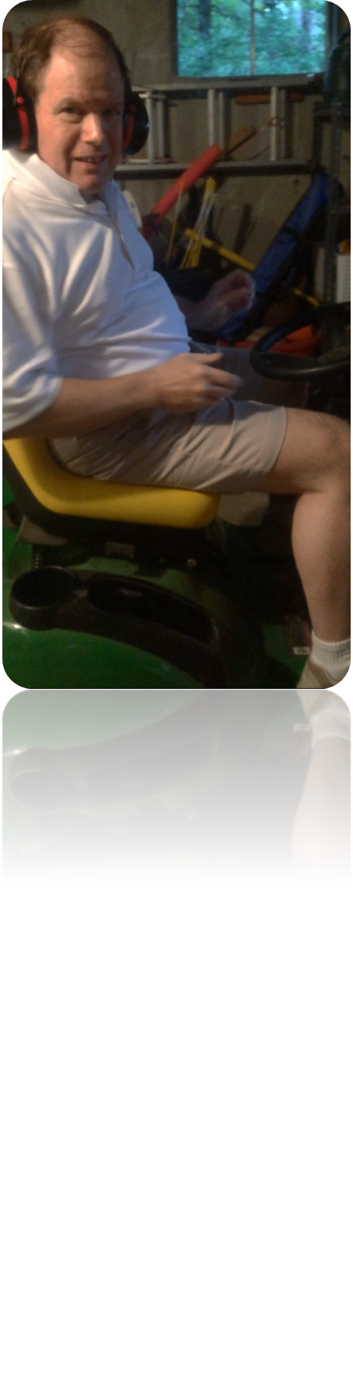
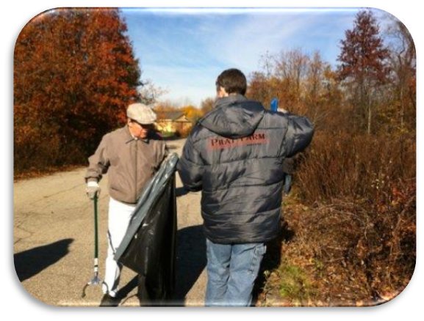
An Outdoorsman
Dave knows the value of hard, physical work. At home, Dave oversees all the grounds maintenance, using skills which he also uses while volunteering at Mass. Audubon Society and the Rose Kennedy Greenway. This includes:
Tractor Mowing Weed Whacking
Leaf Blowing/Removal Snow Blowing
Edging & Trimming
Caption: Dave in his garage, showing the John Deere tractor he uses for lawn mowing.
Caption: Dave, left, collecting trash with a fellow grounds volunteer at Mass Audubon.
13
Notes:
Not listed: Dave as also had experience in equipment outdoors, including experience driving and directing a Boom Lift, Jet Ski and Boats!
Dave grew up close with his father, who was a Naval Lieutenant, and ran the household much like that of a military boot camp – a protocol and procedure for everything, all actions are calculated and exact. Dave operates machinery the same way – with a precision and emphasis on safety that is unparalleled. This will be addressed again as we get further into the resume.

Slide 14
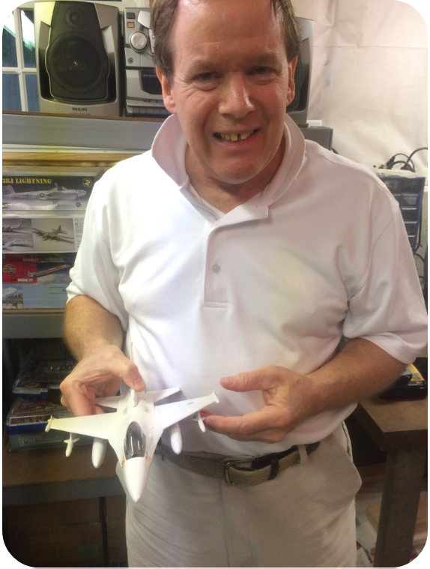
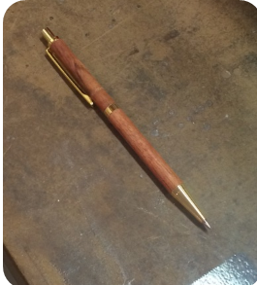
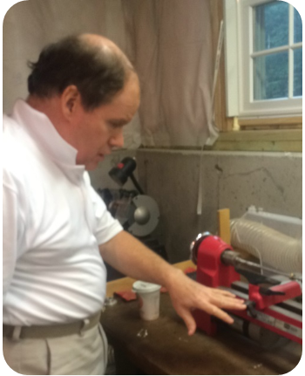
A Craftsman
In Dave’s workshop at home, he enjoys fixing and creating items such as pens, salt and pepper mills, models, and clocks.
Dave owns and operates the following power tools:
Lathe Belt Sander
Grinder Band Saw
Drill Press Scroll Saw
Soldering Iron Power Drill
Observing Dave at work with power tools is a prime opportunity to see his skills and diligent attention to safety procedures in action.
Caption: Dave’s handmade pen.
Caption: Dave showing one of the tools in his home workshop.
Caption: Dave in his workshop at home with a model aircraft he constructed.
14
Notes:
At a visit to Dave’s home, he and his Career Navigator spent the majority of their time together in Dave’s workshop – his favorite place to spend free time
—it is a large basement area with about 8 work-bench style stations, each a designated space for the power tools listed.
-He has a large peg board where his tools are organized by type and size. (pictured later in resume)
-Each piece of machinery was carefully stored when not in use, something that Dave is very particular about.
-Cleaning equipment was also stored along one wall, and Dave uses these items after completing a project, though he DOES NOT want to do janitorial work
-Dave also has work out equipment in a part of the basement near his workshop area. Dave lifts 30-40 lb hand weights and rides the stationary bicycle for 80 minutes 4 days each week: a lot more than most men his age can brag about!

Slide 15
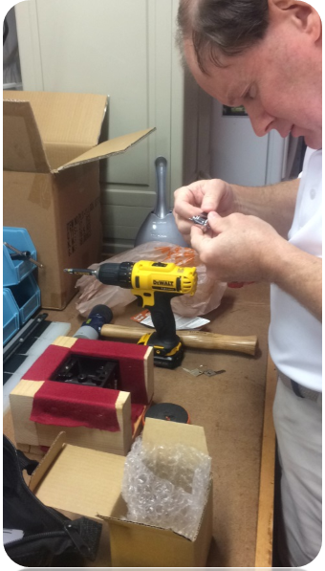
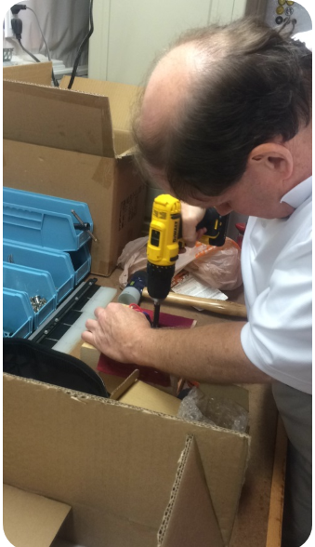
An Independent Contractor with
100% Accuracy
In 2012, Dave was hired by Overland Safety Systems to assemble gun locks. Overland is based in New Hampshire, so Dave receives shipments of incomplete products to assemble in his home workshop.
The gun locks Dave produces are used in law enforcement, military, and private security industries.
John, the co-owner of Overland and an expert in the industry, has said that Dave is one of the few people who consistently assembles the locks with 100% accuracy that he has seen in all his years in the industry.
Caption: Dave in his workshop, assembling an Overland Safety shot gun lock.
15
Notes:
John explained that so few people have Dave’s stamina and ability to produce with such high quality each time. Cindy, Dave’s sister-in-law and primary support person, said that Overland was “Thrilled with production…they wanted to give Dave more work,”
Dave would do this work all the time if it was out in the community, but it is important for him to be out of the house in a place he recognizes as a bigger organization.

Slide 16
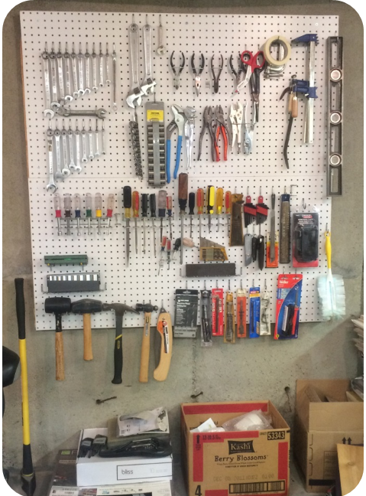
Dave’s Tactical Precision
Dave is routine-oriented, preferring structure and clear expectations both at work and home.
He learns best when taught step-by-step with a demonstration and procedure to follow. Dave is excellent at following visual diagrams of next steps.
Caption: Dave’s hand tool rack in his workshop, which he organizes by type and size.
16
Notes:
An interesting story about Dave’s precision: Dave recently went to a shooting range with his nephew and employer from Overland. From the first shot Dave took, to the last, Dave shot ONLY bulls eyes. It was his first time shooting.
The owner of the range said he’d never seen such excellent “safety technique” in anyone he’d ever encountered.

Slide 17
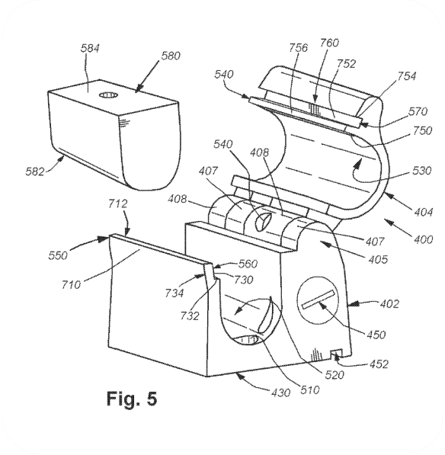
Community Reference
Dave recently went to the Down Range Gun Range with his nephew and employer from Overland. From the first shot Dave took to the last, Dave shot ONLY bullseyes. It was his first-time shooting.
“I have never seen such excellent “safety technique” in anyone I have ever encountered.”
        - William Catering
        Owner of Down Range
Caption: Diagram of the Overland Safety shot gun lock that Dave assembles for the company.
17
Notes:
An interesting story about Dave’s precision: Dave recently went to a shooting range with his nephew and employer from Overland. From the first shot Dave took, to the last, Dave shot ONLY bullseyes. It was his first time shooting.
The owner of the range said he’d never seen such excellent “safety technique” in anyone he’d ever encountered.

Slide 18
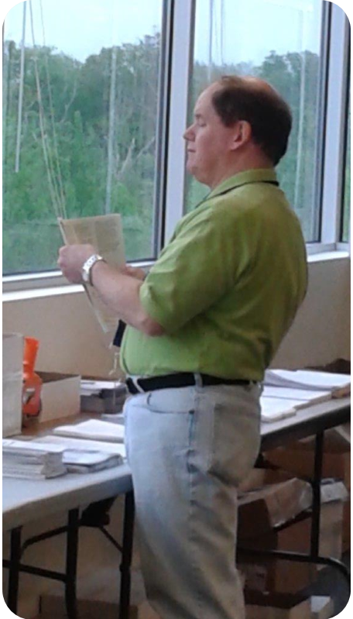
Dave’s Experiences
Kaye Instruments, manufacturing
American Dryer, manufacturing & assembly
Overland Security Systems, assembly
Hills Department Store Corporate Office, custodian & maintenance
Volunteering: MASSCP, Dorchester Multiservice Center, Mass Audubon Society, Community Servings & More
Caption: Dave assembling HR packets at MASSCP.
18
Notes:
Dave was recently offered a job at one of his regular volunteer sites, MASSCP, where he assembles packets of administrative materials. Supervisors said he could produce the materials at such a high volume and quality level, they wanted to bring him on board for regular work. However, Dave is eager to work with power tools and equipment, and the commute made this offer inaccessible to his transportation company.

Slide 19
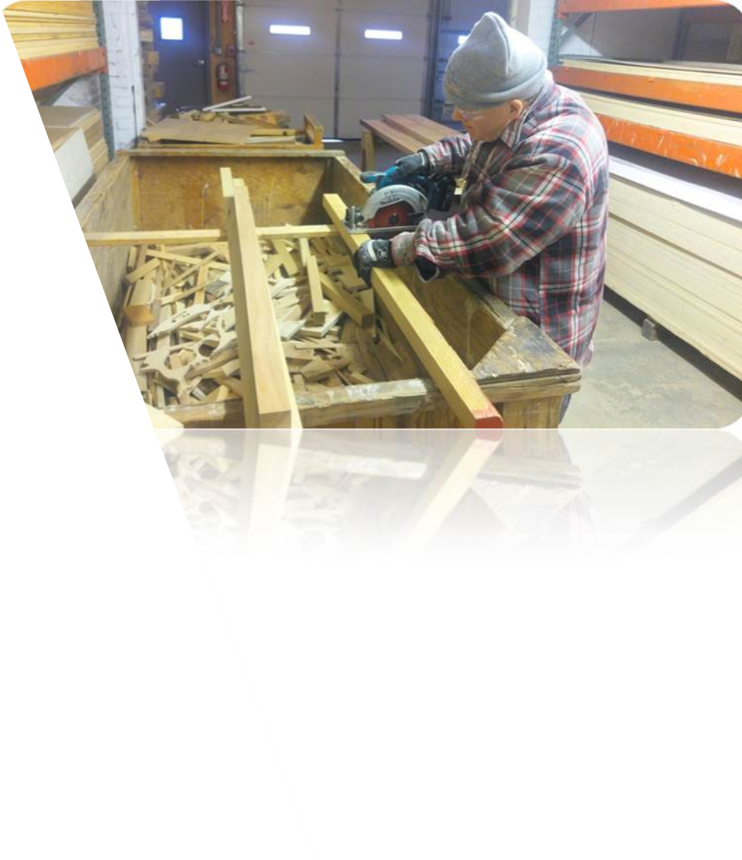
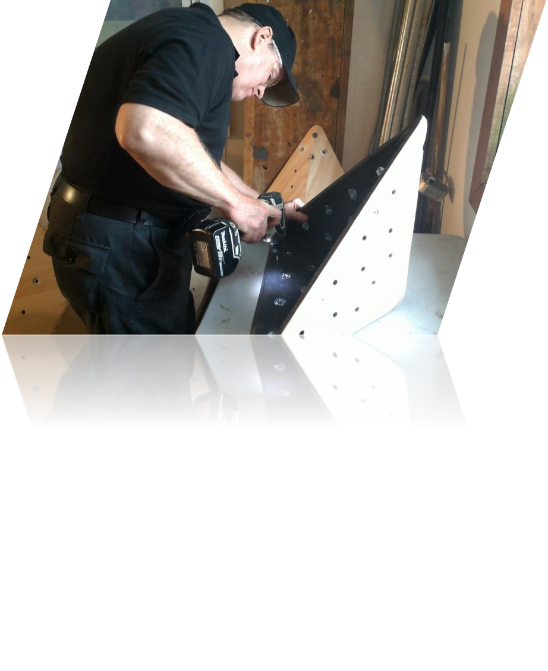
Dave is seeking a job in which he may perform tasks such as…
Following diagrams, manuals, procedures, and safety protocols to complete production of various items
Utilizing power tools, machinery, and equipment to contribute to contracted carpentry jobs
Sanding and prepping wood for later use
Organizing/categorizing of tools and equipment and/or storing them accordingly
Assembly/disassembly of small machines and structures
19

Slide 20
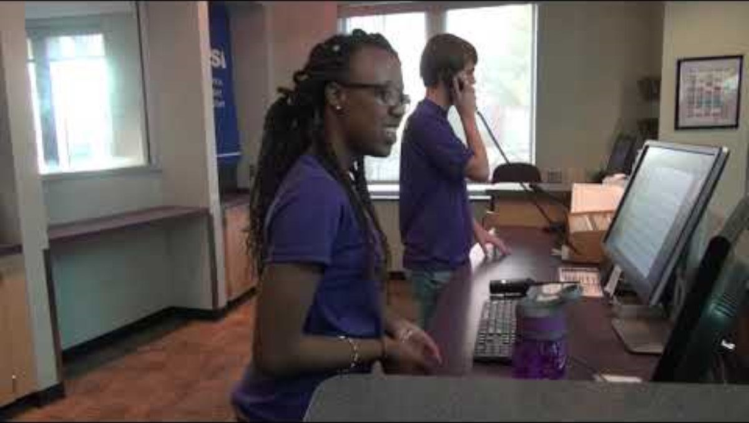
Video Resume Example
20

Slide 21
Social Media for Networking & Marketing Job Seekers
21

Slide 22
Why Networking?
People conduct business primarily with people they know and like. Resumes and cover letters alone are often too impersonal to convince employers to hire you.
Job listings tend to draw piles of applicants, which puts you in intense competition with many others. Networking makes you a recommended member of a much smaller pool.
The job you want may not be advertised at all. Networking leads to information and job leads, often before a formal job description is created or a job announced.
22

Slide 23
“Networking is not about just connecting people. It’s about connecting people with people, people with ideas, and people with opportunities.”
--Michele Jennae,
Consultant, Writer, Artist
23
Notes:
http://michelejennae.com/writer/

Slide 24
Common Terms Used on Social Media
Friend
Like
Follower
A friend is a person that you connect with on Facebook. Unlike a fan or follower, a friend is a two-way connection—both you and your friend must endorse the relationship. Facebook business pages cannot have “friends,” only fans or followers.
A fan is someone who likes your Facebook Page. “Fan” is sometimes used more generally to refer to someone who follows you on any social channel, but only Facebook officially uses this term.
A follower is a user on social media who has subscribed to see your posts in their feed. Both personal and business accounts can have followers. Your number of followers, or follower count, is a key metric for seeing how your audience on social media is growing or shrinking over time.
Notes:
Influencer: Influencers in social media are people who have built a reputation for their knowledge and expertise on a specific topic.

Slide 25
Social Media Symbols to Know
The “Hashtag” #
The “At” @
“Hashtags”/# are a way to group posts together on social media. They are preceded by the “#” symbol and can be used on Twitter, Facebook, Google+, and other platforms. When you click on a hashtag in a post, you'll see all the other posts that also use that same hashtag.
Example: #recruiting, #ITjobs
“At”/@ represents a way to alert a person/entity/group of a conversation in which that you are talking to them, giving them a heads up, or wanting them to respond to something said or shared.
Example: @ICI, @JobSeeker, @EmploymentSpecialist, @APSE, @everyone, @followers
Notes:
The best way to think of the difference between these two tags is that using the @ refers to a person/group in a conversation, and the # refers to a topic of conversation. Using the # tag generally indicates that you want to participate in a larger, ongoing conversation - for example, a conference (#SHRM15) or a popular subject (#socialmedia). Using the @ tag signifies to someone that you’re talking about them, giving them a head’s up about something, and/or would like them to respond.

Slide 26



Social Media Networking for
Employment Specialists & Job Seekers
LinkedIn
Facebook/
Instagram
Notes:
Keep in mind: employers check social media sites of prospective employees as well as current ones.
We will talk more about ethical, privacy, and safety considerations a bit later.

Slide 27

LinkedIn
Designed to connect you to people you know, network with their contacts, to connect you with people you want to know.
Professional Photo & Profile Summary
Recommendations & Endorsements
Social Media Resume & Skills
Networking/Groups
Company Search
Job Postings
Email
Posts
* Consider customizing the default URL to include identifier (your name) as an extension following http://www.linkedin.com/in/* so that it is more recognizable.
27
Notes:
Profile: Create a complete and professional profile page including adding a current, appropriate photo (so colleagues, friends, and acquaintances can recognize you).
Recommendations: Post recommendations and endorsements from (at least 3) past employers and colleagues
Post Social Media Resume: Use multi-media approach
Skills: at least 5
Company Search: Find people who are connected to a company who could introduce you
Job Postings: View job openings posted by employers
Email: Email everyone in your LinkedIn network to ask for contacts, ideas, and connections
Posts: Posts are a great way to gain attention on LinkedIn and establish yourself as an expert in your field. Why is it worth doing? Because it elevates your position as a professional by showing that you care enough to share insight, initiate conversation, and raise the collective understanding of your industry. The quality of your posts are important, and so is the fact that your LinkedIn posts have a greater chance of being seen by a recruiter than your posts on other social networks.
URL: The default URL that comes with your LinkedIn account is difficult to share with people. Who will remember a string of random numbers? Instead, customize your URL from LinkedIn’s Public Profile Settings page. Create a custom URL that includes your name separated by dashes, such as:
linkedin.com/in/john-doe
linkedin.com/in/john-doe-chicago
linkedin.com/in/john-doe-project-manager
A customized URL is easier to remember and tell to people, and it looks good on a business card or resume. There are also SEO (search engine optimization) benefits.

Slide 28
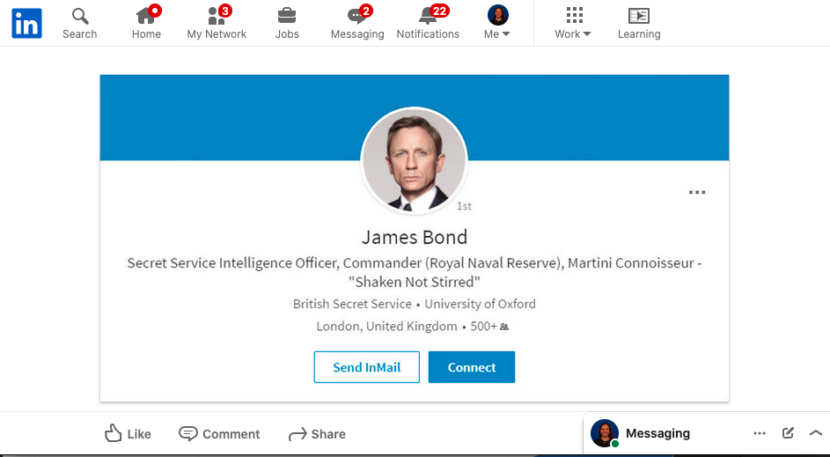
LinkedIn
28
Notes:
Search (by topic, field, business, contact)
Network (look at your network’s network)
Job exploration
Messaging
LinkedIn Learning
YouTube link walking through how to create and maintain a professional and effective LinkedIn profile
https://www.youtube.com/watch?v=qG4NF-2tt4c

Slide 29
Facebook & Instagram
Designed to help you stay connected to people and businesses.
Profile: Include interests, affiliations, and more
Privacy: Restrict settings for safety
Photos: Select those that present you well professionally
Comments: Use politically correct language and proper spelling, grammar, syntax
Reels/Posts: Create content to inform friends about your job search, to ask for networking opportunities, and to get ideas
Like/Follow: Like and follow pages and creators who are likeminded or experienced in your field of interest
Notes:
Do not disparage past or current employers
Consider having both personal and professional social media (both employment specialists and job seekers)

Slide 30
Social Media Communication
Best Practices
Employment Specialists & Job Seekers (1)
DO…
Consider creating two separate social media profiles (personal & professional).
Keep social media “handles” and email addresses appropriate.
Upload a respectful picture; limit use of personal information in profile.
Engage in ways that enhance your individual professional and/or job seeker’s brand; avoid mistakes that can hurt them.
Follow local news, industry trends, employers of interest, etc.
Prioritize safety.
Notes:
Current and prospective employers check social medial profiles of candidates/employees from time to time—remember this yourself and assist your job seekers in creating a strong social media presence and actually use it for networking, job development, and business engagement!
Do not use nicknames (use your name, so you’re easy to find); avoid socially inappropriate language in email addresses, social media profiles, etc.

Slide 31
Social Media Communication
Best Practices
Employment Specialists & Job Seekers (2)
DO NOT…
Post any photos or statements you would not want your potential (or current) employer to see.
Post negatively about current/past employers or organizations.
Give out personal or location information.
“Blast” (overwhelm with many posts)
31

Slide 32
Social Media: Supporting Job Seekers
Help job seekers make informed choices about social media as part of a job search strategy.
Remind individuals to keep profiles/postings/comments professional. Check to verify when possible.
Ensure that job seekers can understand & manage their accounts safely or with assistance:
  -Do not meet people alone or in isolated settings
  -Do not give out any personal information
  -Do not give out status and location details
“Google” search job seekers (as well as yourselves)
Teach job seekers how to connect with members of their networks, search for jobs, engage with employers, and follow trends

Slide 33
Internet Safety 101
Type of Information
Examples
Personal Contact Information
Financial Information
Passwords/Password Hints
Travel Status
Anything you do not want others to share
Do not post addresses and phone numbers (home, work)
Do not post pictures of checks, bank account numbers, or credit cards—Do not post about finances in general
Do not post your password or give any information away that might be helpful in guessing it
Do not post about going out of town, pictures of vacation, etc.—Consider not “checking in” online
Do not post anything damaging to your professional character/career
Notes:
Personal Contact Information
Financial Information
Passwords/Password Hints
Travel Status

Slide 34
Ways Employment Support Professionals can use Social Media
Find Networking events and job fairs
Find new businesses, research businesses
Follow industries and professional groups
Follow local and federal Disability Employment Agencies
Follow local independent news outlets
Support local businesses that hire people with disabilities
Promote success stories
Build relationships with colleagues in the industry
Find training opportunities
34

Slide 35
Ways Employment Agencies can use Social Media
Employer Awards
Success Stories
Job seeker profile or self-employed business highlight
Share events and fundraisers
Share a link to their newsletter
Share news articles
Garner support with advocacy
Share staff accomplishments
35

Slide 36
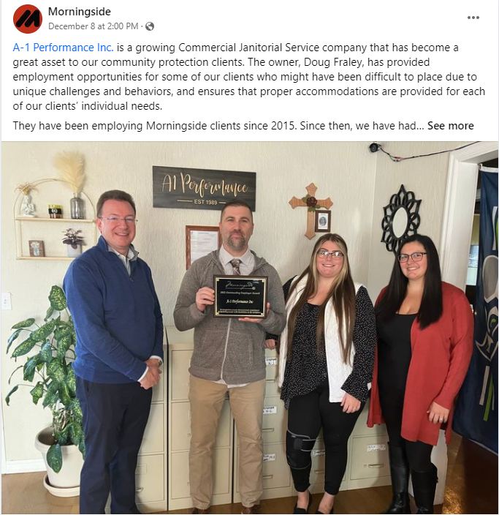
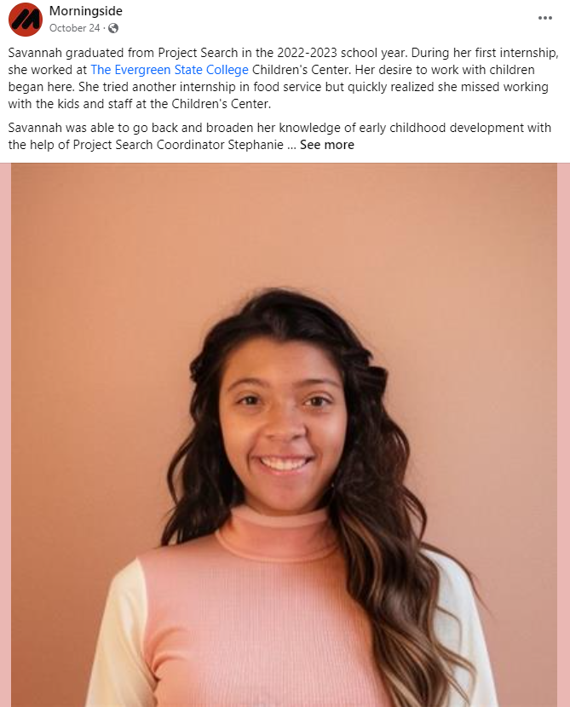
Social Media: Agency posts
Morningside Services Facebook

Slide 37
Ways Job Seekers and Self-Employed can use Social Media
Promote their business
Share self-advocacy videos or visual resume
Share work accomplishments
Network
Find industry mentors
Advocacy groups
Connect with past employers/co-workers
37

Slide 38
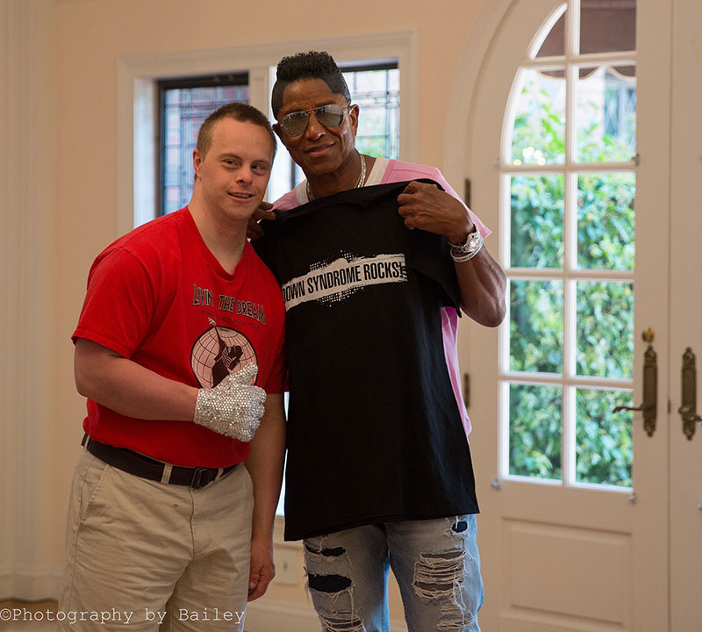
Social Media: Entrepreneur/Mentorship
Dylan Kuehl
Visual artist, jewelry maker, dancer, musician
First person with Down Syndrome to Graduate from a Washington State College
YouTube (@dylankuehl6855) gained the attention of the Jackson family
Performed for Jermaine and Katherine Jackson
World tour with his Michael Jackson Tribute Band : Healing the World and Living the Dream
Website: https://oly-wa.us/dkarts/about.php
38

Slide 39
Social Media Suggested Follows
Greater Boston Chamber of Commerce: Facebook, LinkedIn
Massachusetts Executive Office of Labor and Workforce Development: LinkedIn
Commonwealth of Massachusetts: LinkedIn
Massachusetts APSE: Facebook
Massachusetts Regional Employment Collaboratives: LinkedIn

Slide 40
Useful Resources
Department of Developmental Services:
  https://www.mass.gov/supportive-technology
MassAbility:
https://www.mass.gov/service-details/mrc-il-assistive-technology-program
Employment First Massachusetts:
  https://employmentfirstma.org/
JAN
  https://askjan.org/
ICI Publications
  https://covid19.communityinclusion.org/
Planning for Autism
  https://www.planningforautism.com/

Slide 41
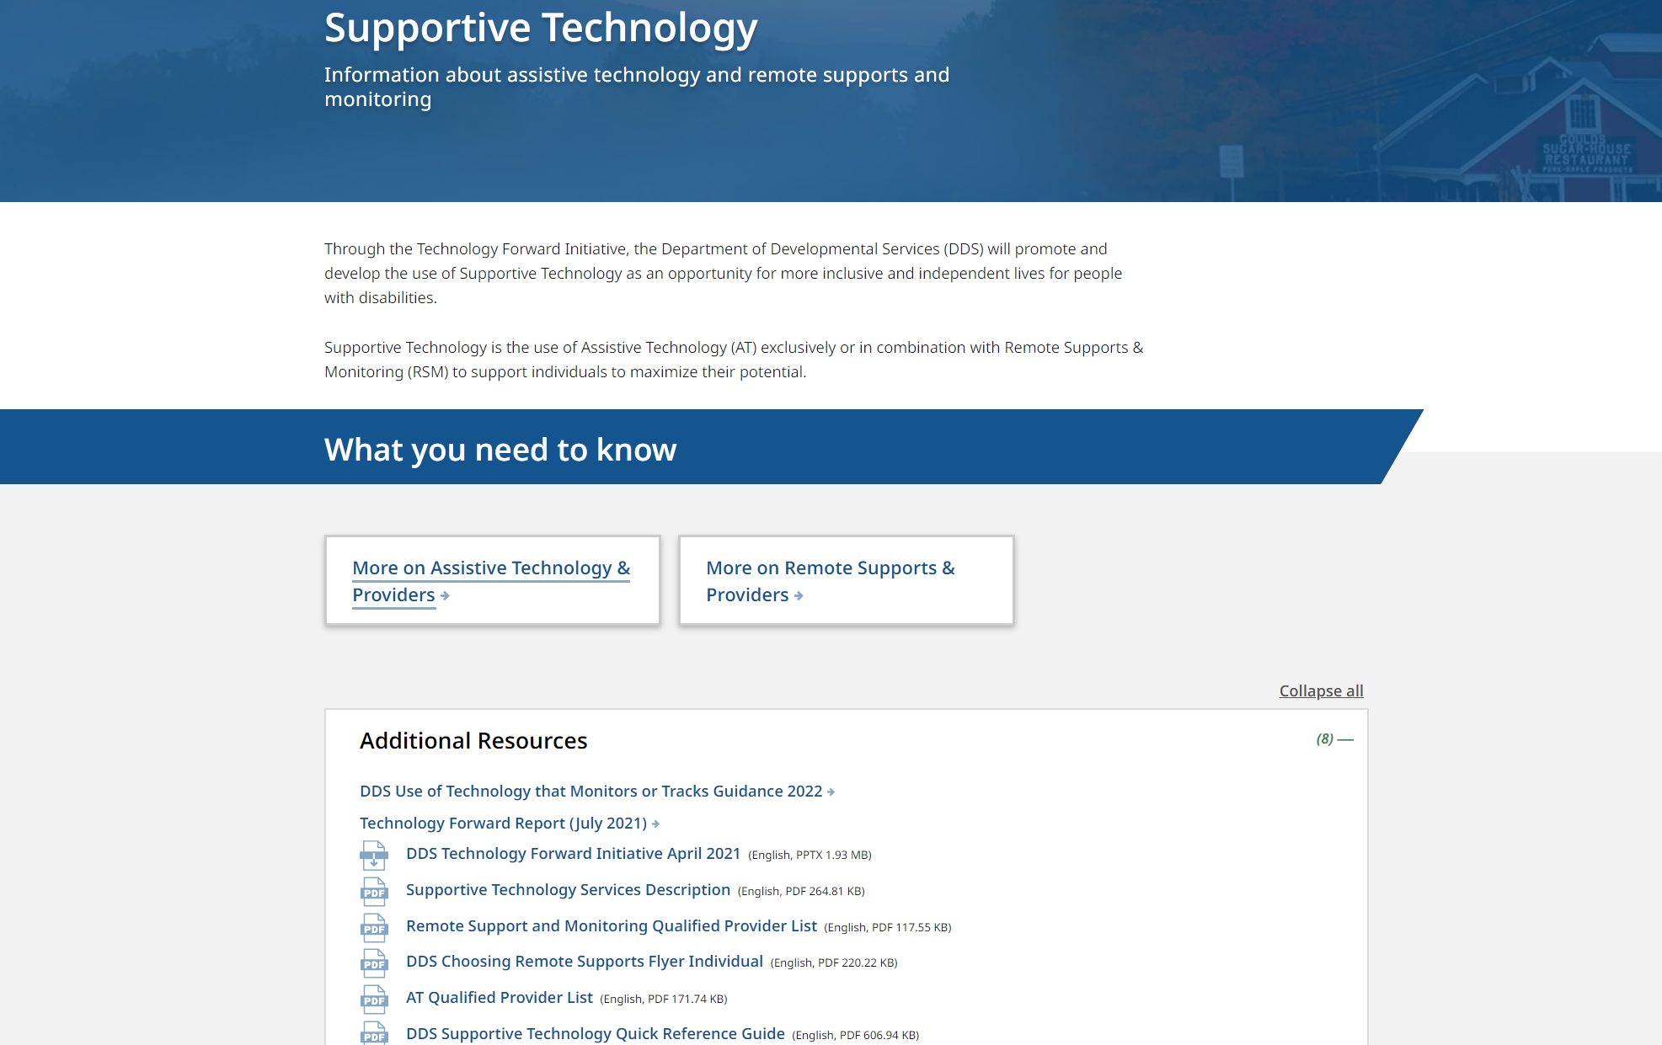
Department of Developmental Services:
https://www.mass.gov/supportive-technology

Slide 42
Summary
Understanding the benefits of networking remains fundamental to providing quality and effective employment services to job seekers with disabilities. Using social media technology responsibly to connect and enhance relationships, explore fields of interest, search for jobs, follow labor market trends, get up-to-date information, and market job seekers , could be a valuable tool for both job seekers and employment specialists alike.

Slide 43
Thank you!
Last questions…comments?
43
Notes:
https://umassboston.co1.qualtrics.com/jfe/form/SV_8e8JFTOCihkjtwq

